Slide 1
GHG Removal
GGGS 621

Slide 2
Housekeeping
Proposal is due on October 18
Syllabus updated with new readings and new CDR session
Zoom guest lecture on 9/27
Please submit paper critique slides to TA
TA office hours: Monday 2-4 pm N5

Slide 3
Course schedule and topics
Date | Lecture Topic (w/ Guest Speaker) | Readings | What’s Due | Paper Critique
8/30 | Introduction to IAM | Reading 1 |  | -
9/6 | Foundations of IAM | Reading 2 | Assignment 1 | -
9/13 | Energy System | Reading 3 |  | -
9/20 | Land System | Reading 4 | Assignment 2 | 박소민
9/27* | Emission System (Prof. Yang Ou) | Reading 5 | Assignment 3 | 조정호
10/4 | GHG Removal | Reading 6 | Assignment 4 | 안지석
10/11 | Water System | Reading 7 |  | 최지우
10/18 | Mid-Term: Project Proposal |  | Project proposal
10/25 | IAM in International Climate Policies | Reading 8 |  | Nguyen
11/1 | Standardized Scenarios | Reading 9 | Assignment 5 | Ahmed
11/8 | Multi-model Comparison | Reading 10 | Assignment 6 | Pei Jia
11/15* | IAM in National Strategies (TBD) | Reading 11 | Assignment 7 | Andhika
11/22 | Mitigation and other SDGs | Reading 12 | Assignment 8 | 이정미
11/29 | Uncertainty in IAM and Climate Change | Reading 13 |  | 박시은
12/6 | Food-Energy-Water Nexus | Reading 14
12/13 | Final project presentation 1 |  | Presentation

Slide 4
Agenda
1:00 GHG Removal Technologies
Recap of Previous Lecture
Today’s Lecture
Q&A
2:15 Break
2:30 GCAM Tutorial
Paper Critique
Discuss Previous Assignment
New Modeling Assignment
Proposal writing

Slide 5
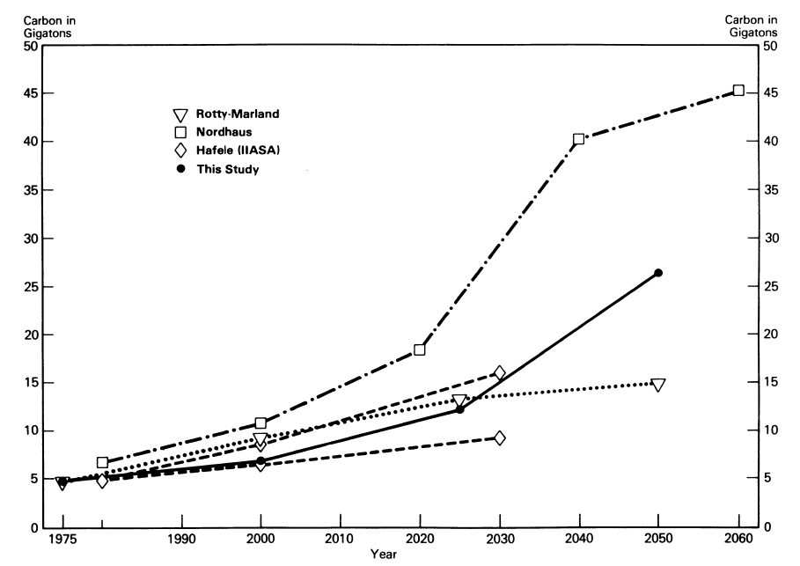
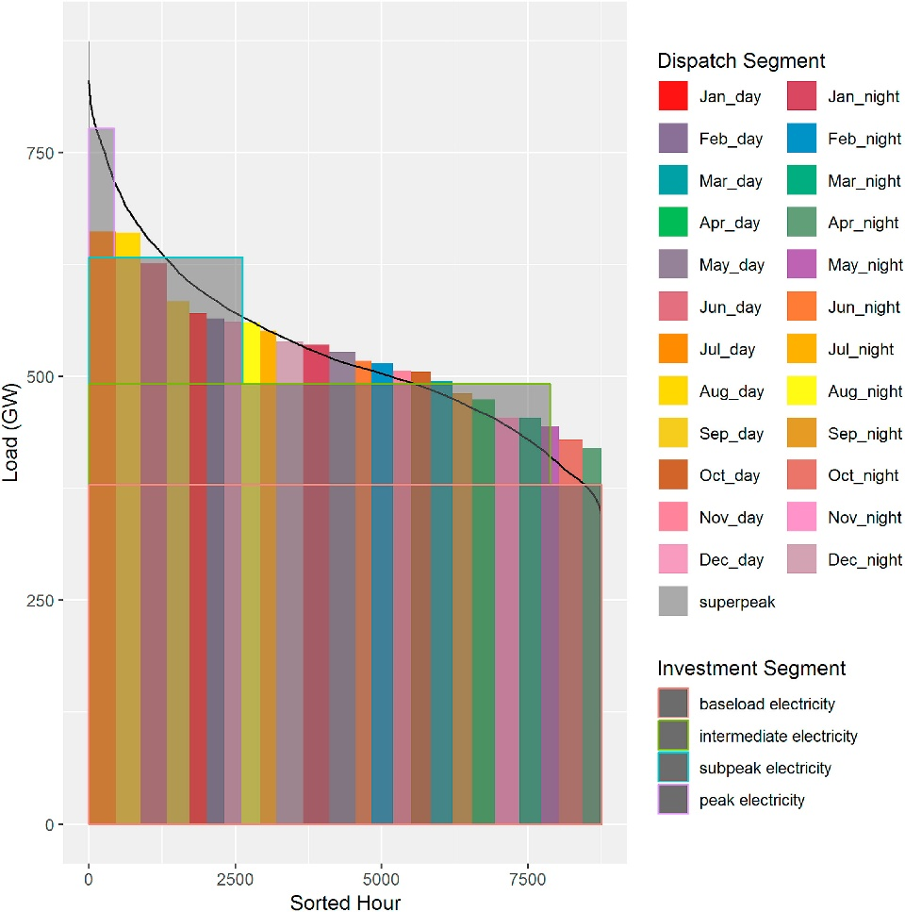
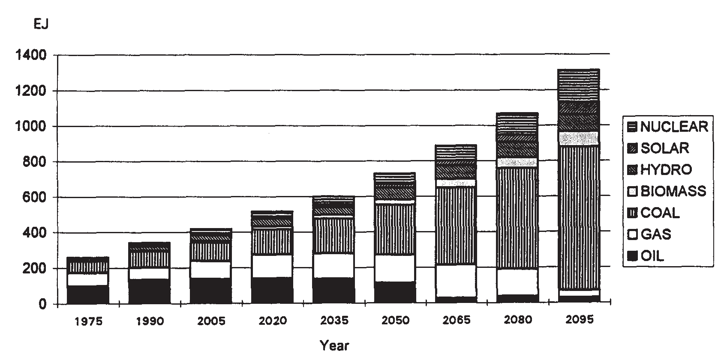
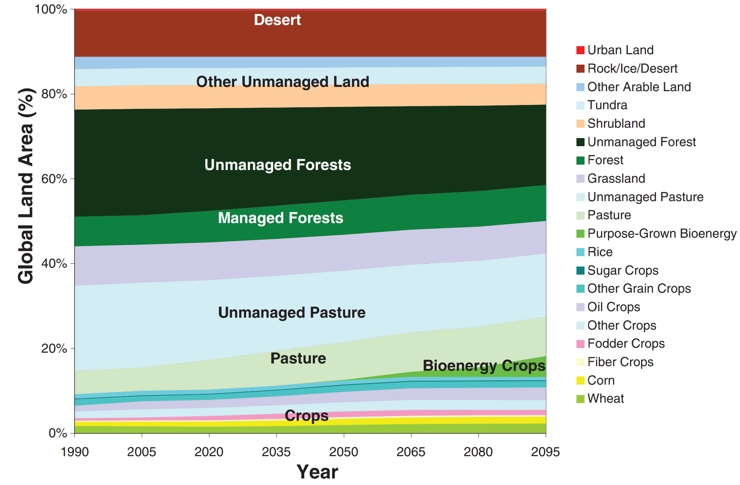
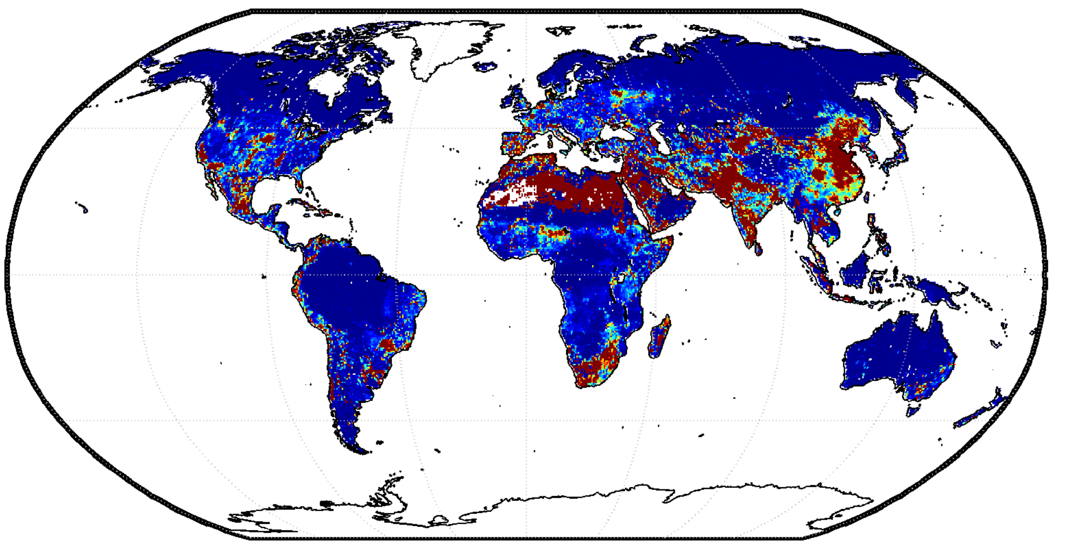
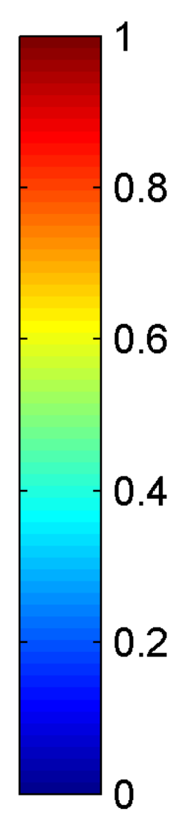




The Evolution of GCAM Research
1980s
Projections of emissions and concentrations
Understanding the complex interactions among energy, water, land, climate, socioeconomics, and other important human and natural systems at regional to global scales
2015–Present
Integrating impacts
Edmonds and Reilly (1983). The Energy Journal.
Wise et al. (2019). ESR.
1990s
2010s
Energy and Technology
2000s
Water system
Land use system
Water Scarcity Index
Edmonds et al. (1995).
Energy Policy.
Wise et al. (2009).
Science.
Hejazi et al. (2014). HESS.
ENERGY-ECONOMY-CLIMATE
ENERGY-ECONOMY-LAND-CLIMATE
ENERGY-ECONOMY-LAND-WATER-CLIMATE

Slide 6
Lecture

Slide 7

Break

Slide 8
GCAM Tutorial

Slide 9
Agenda
1:00 GHG Removal Technologies
Recap of Previous Lecture
Today’s Lecture
Q&A
2:15 Break
2:30 GCAM Tutorial
Paper Critique
Discuss Previous Assignment
New Modeling Assignment
Proposal writing

Slide 10
Paper Critique

Slide 11
Assignment #4
Run two GCAM low-carbon scenarios with the same emissions cap but with or without land carbon pricing
Need to calculate the global net CO2 emissions from the carbon tax scenario in Assignment #2.
Hint: You will need to sum the total of two queries for net CO2 ("CO2 emissions by region" and "LUC emission by region”)
Plot the differences and answer the questions
Globally, how much energy carbon emissions reductions achieved under each policy design? How much LUC emissions reductions achieved?
Globally, how will bioenergy consumption change between the two policy designs? And how will cropland and forest cover change?
Globally, how will food prices and food consumption change between the two policy designs?

Slide 12
Assignment #6
Run a GCAM zero emission scenario (same as last week)
If you go to zero too quickly, the model may not solve (that’s ok)
Extra credit: run the scenario with novel CO2 removal technologies
Plot the negative emission sectors vs. recalcitrant positive emission sectors.
Which sector is the hardest to abate?
Which sectors provide negative emission room for residual emissions?

Slide 13
Project proposal
Full project proposal is due on October 18. It should include the following components:
objective/questions of your project;
proposed scenarios;
methodology (assumptions, GCAM inputs to be used, edited);
data required and sources of information;
expected results and conclusions.
Feel free to send me an early idea to see if your proposal would be feasible.
E.g. don’t propose to model Mars climate.
Focus on one region and/or one sector.
Keep it simple, but with room to expand afterwards.

